Slide 1
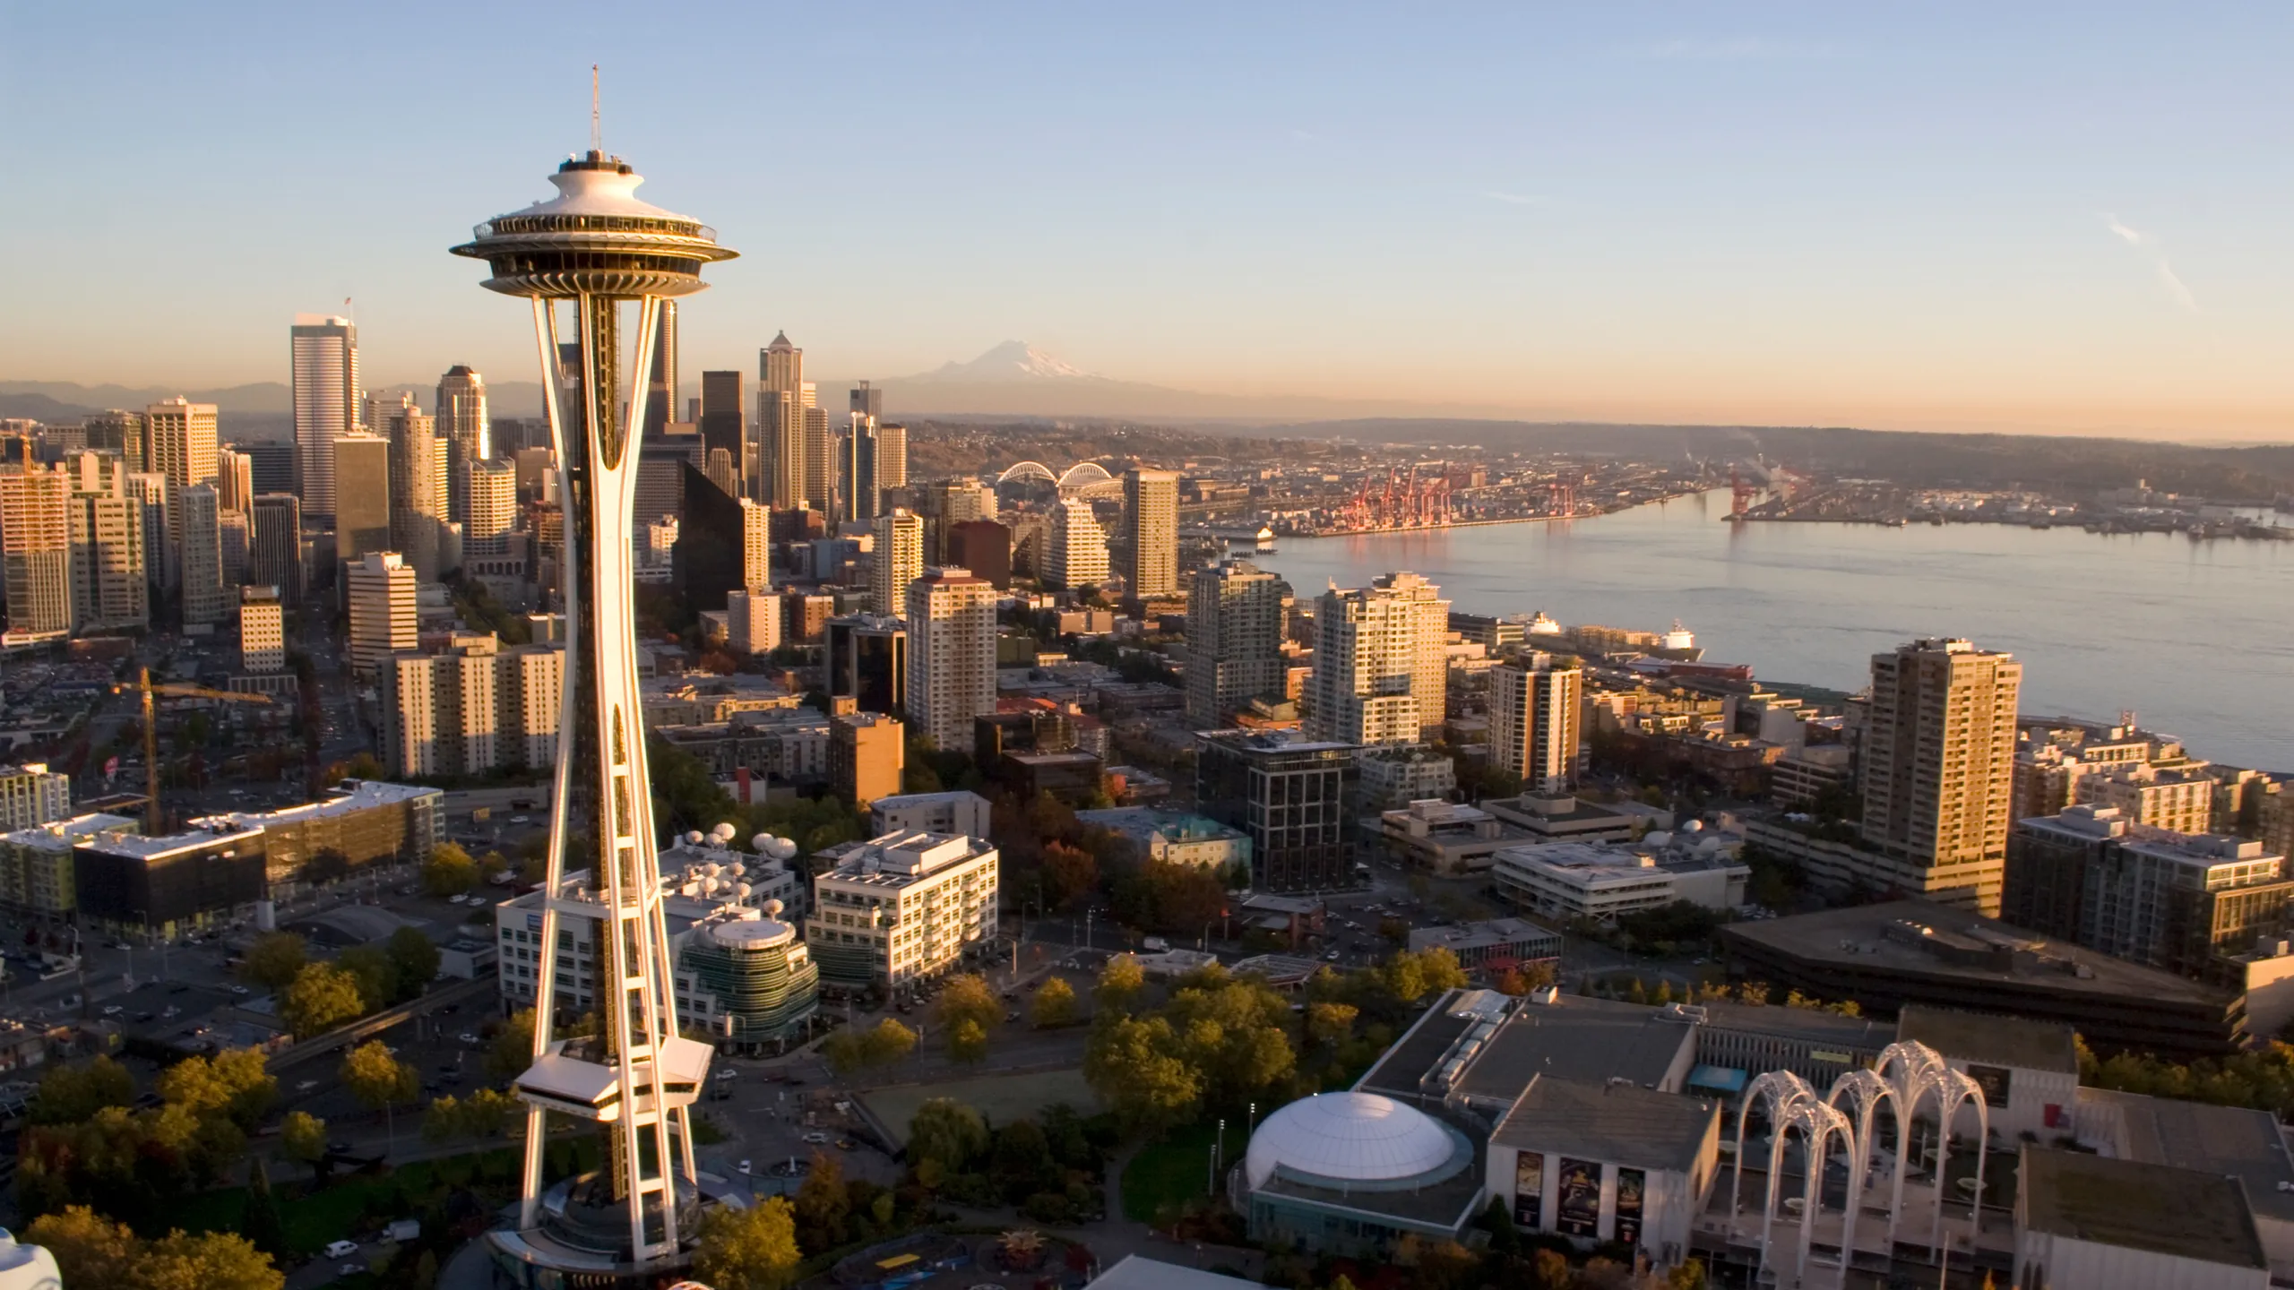
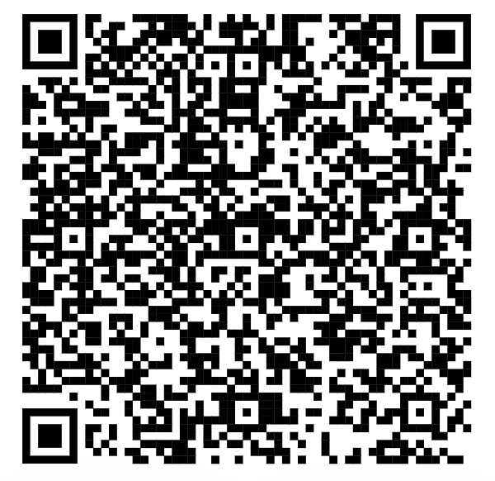
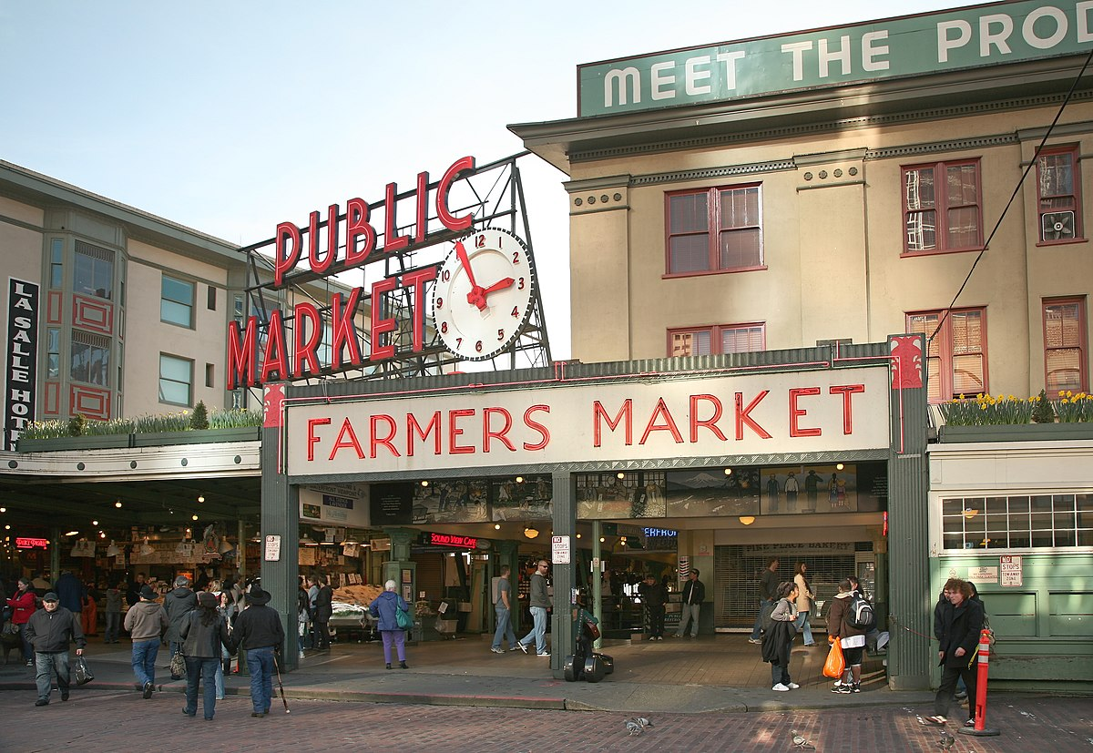
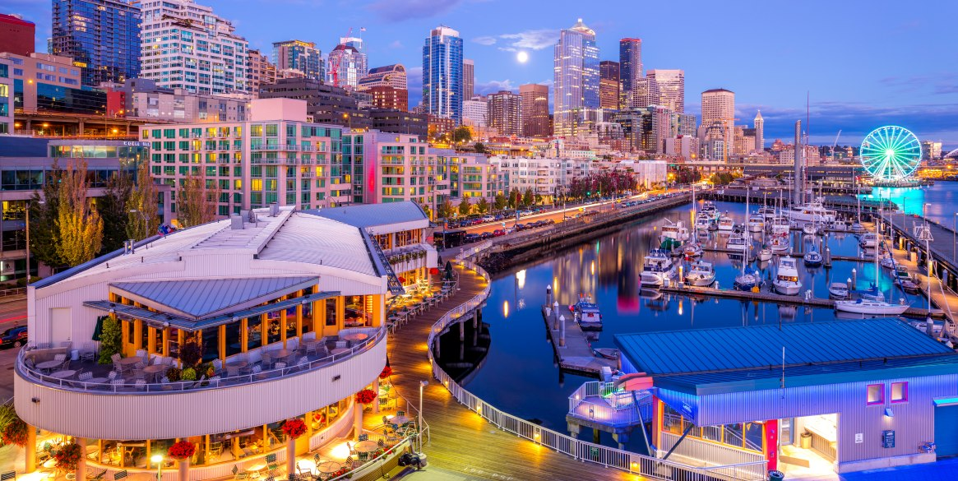
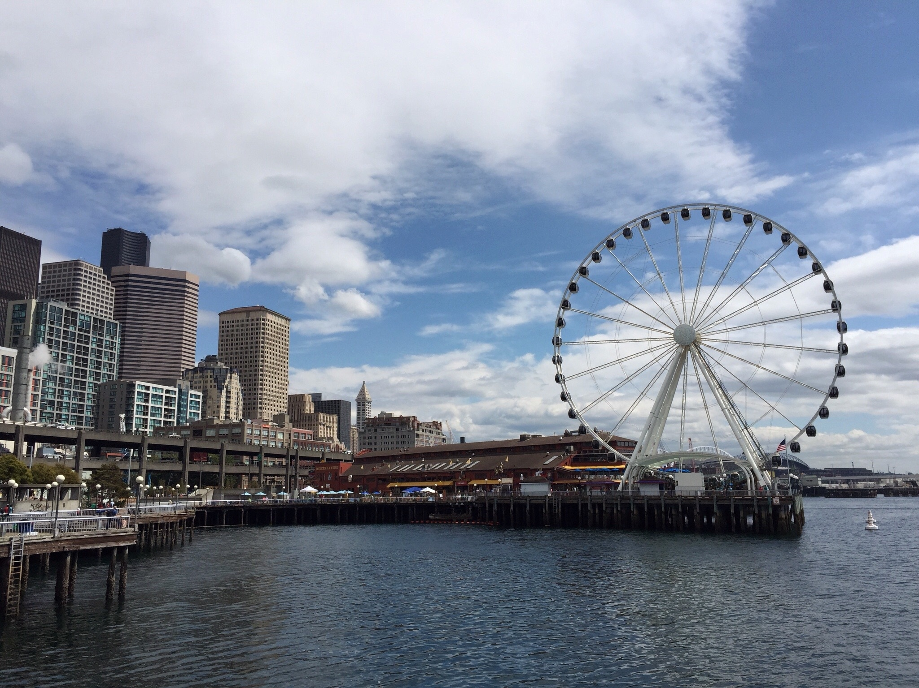
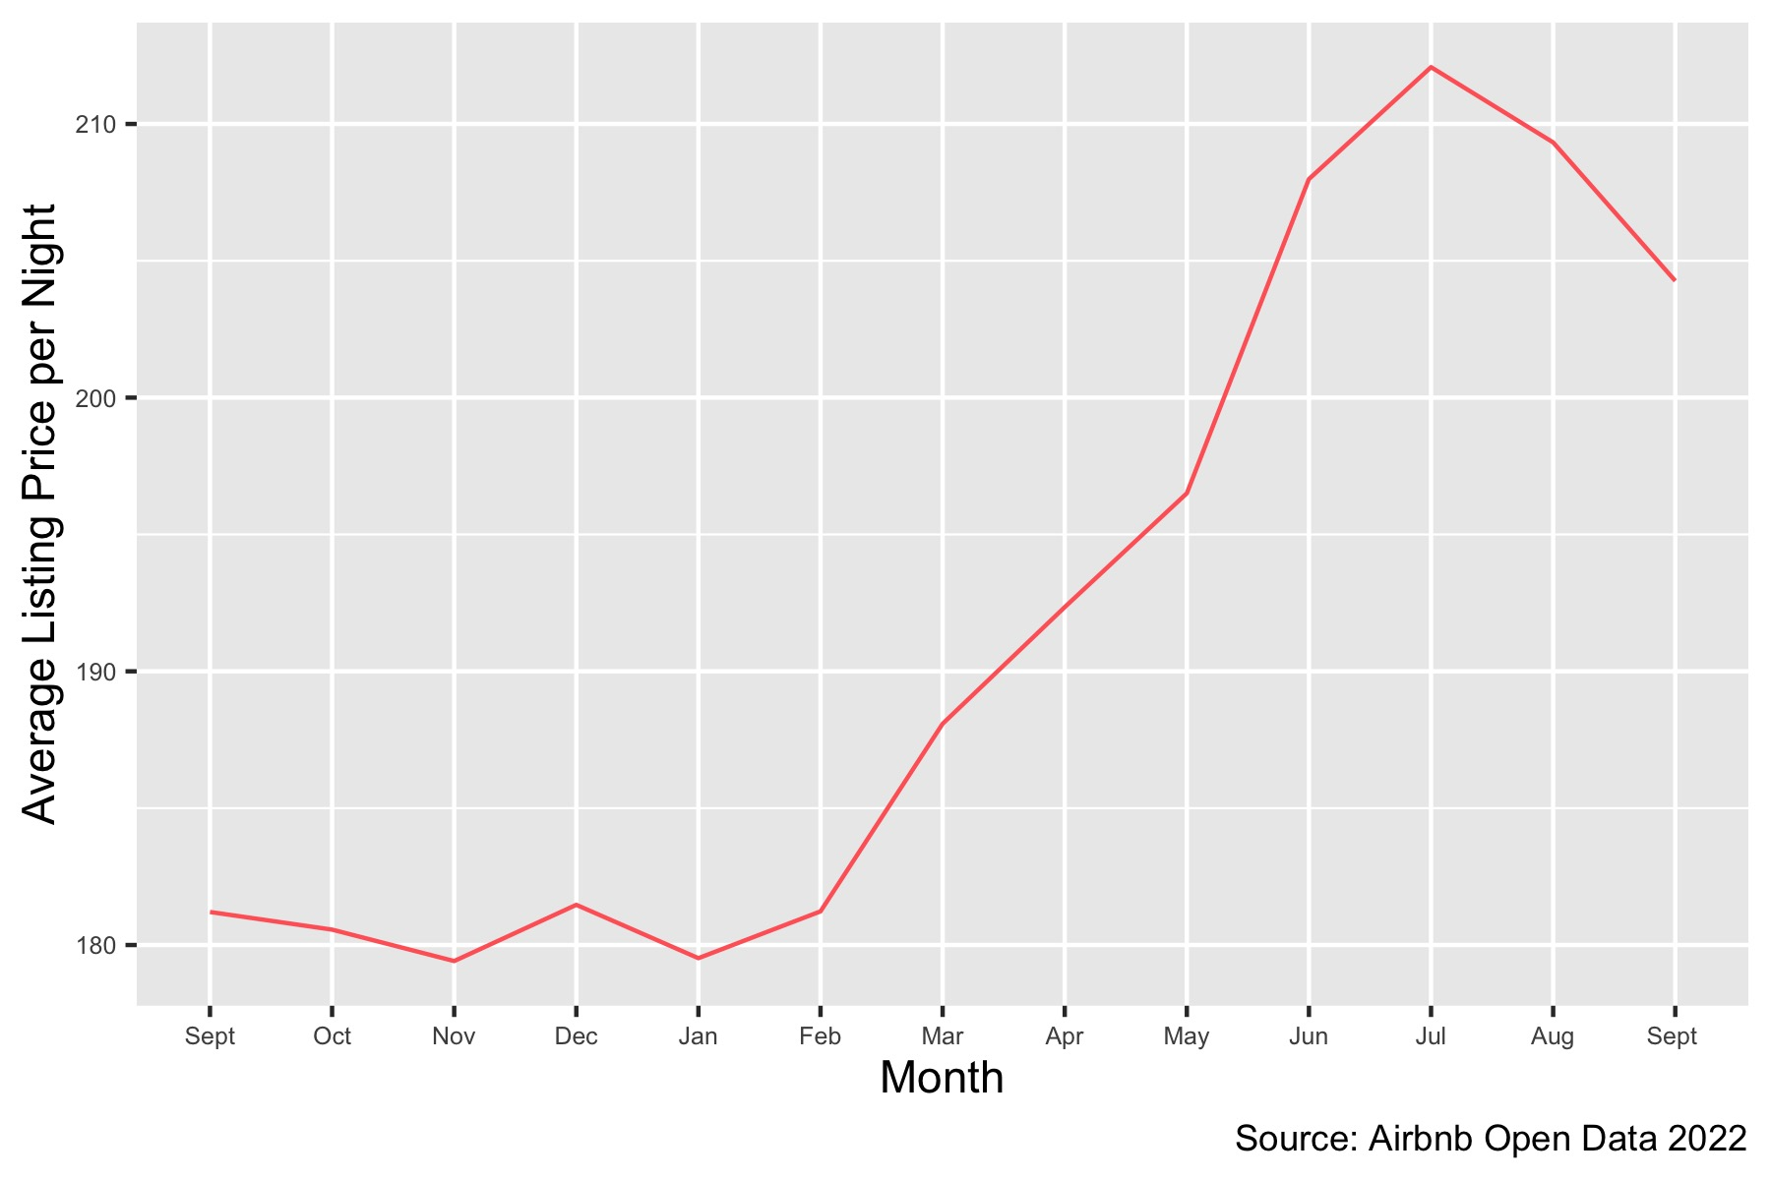
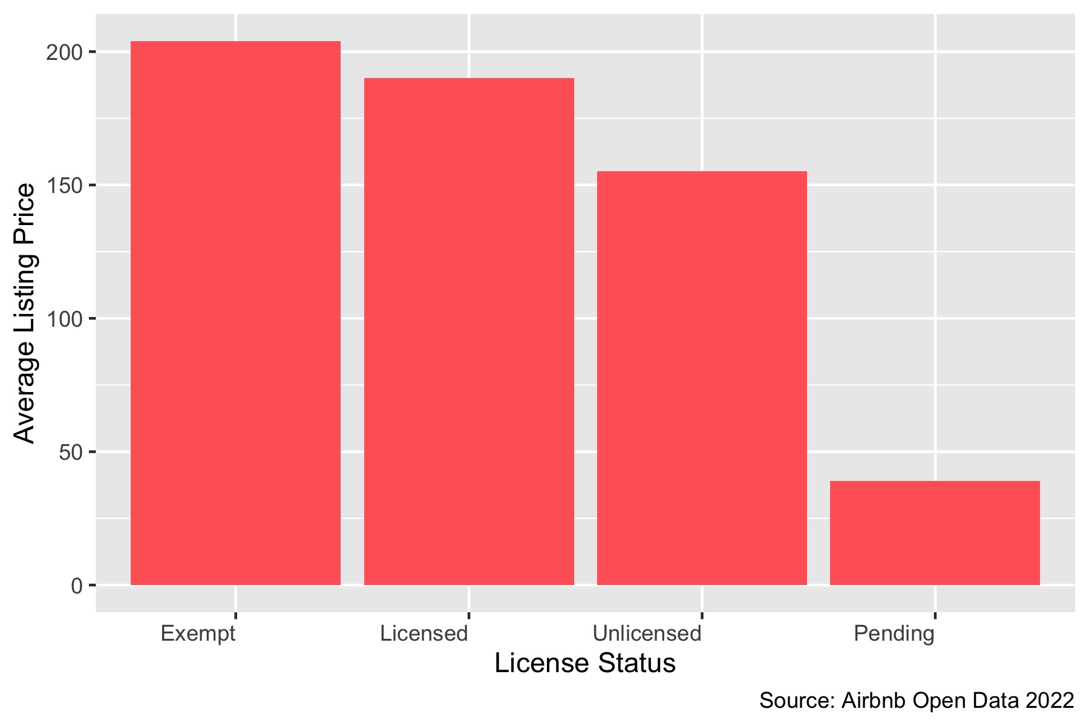
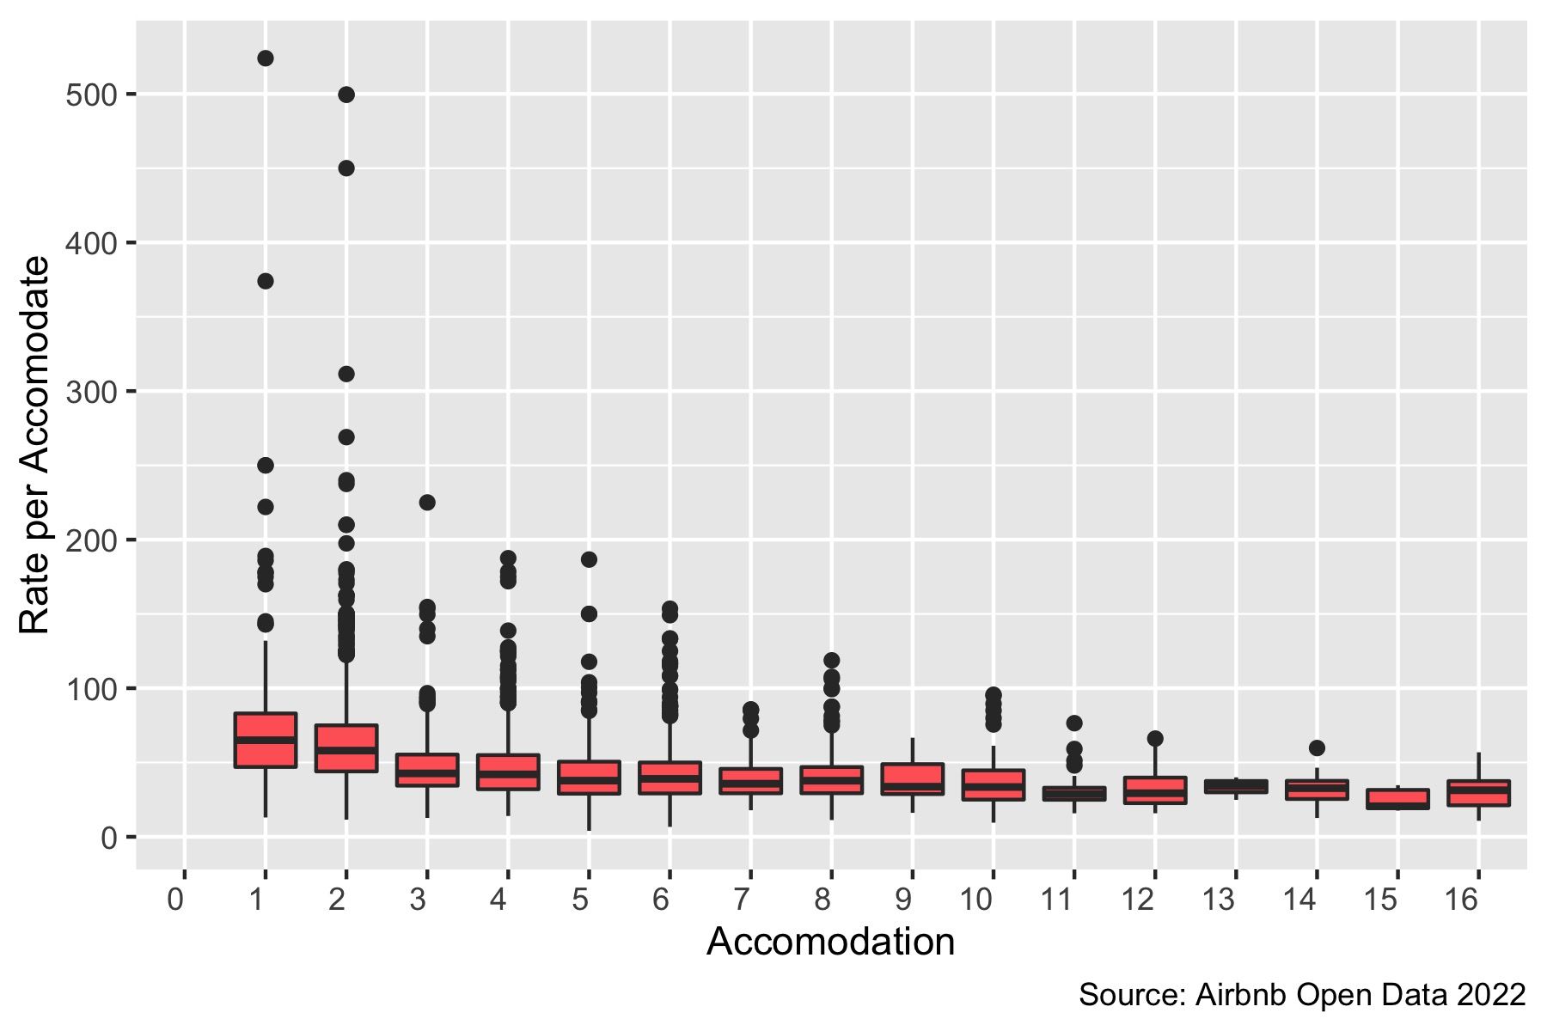
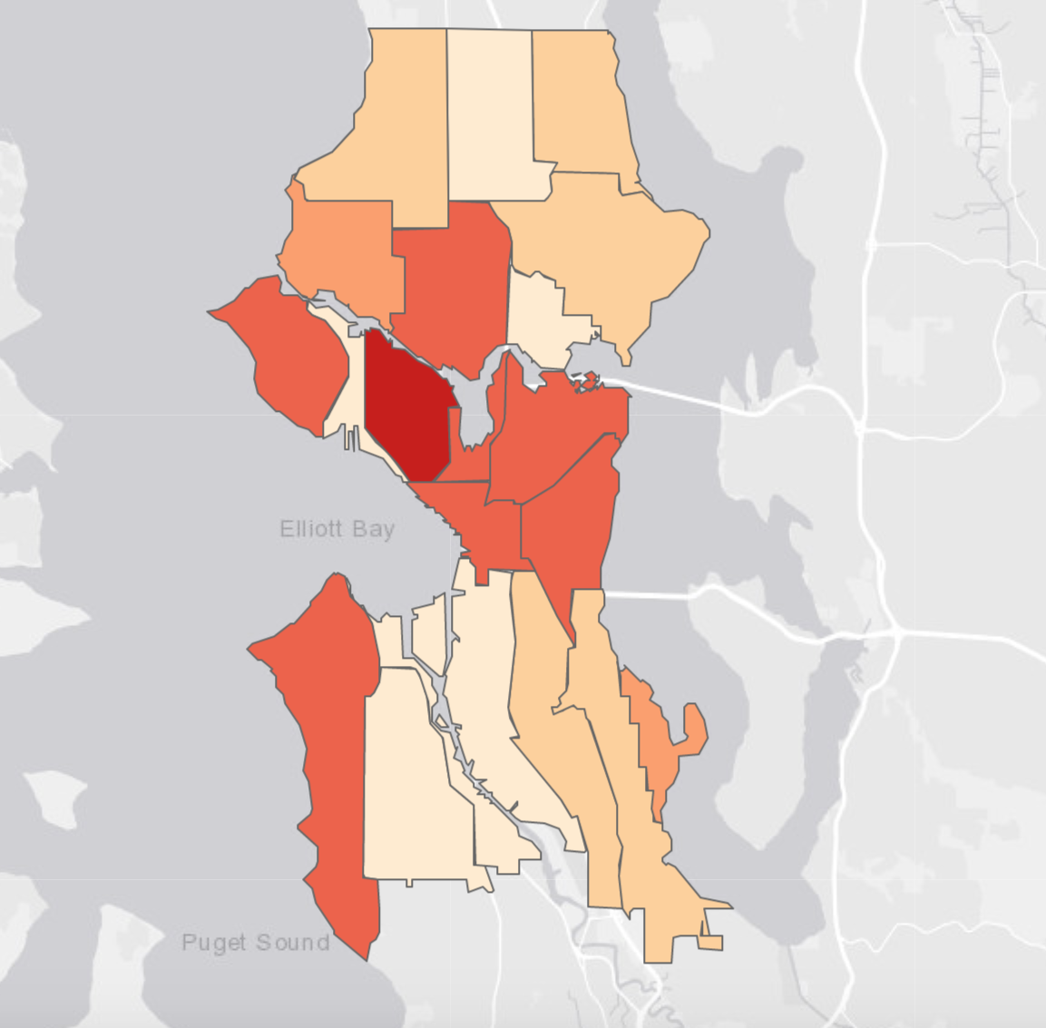
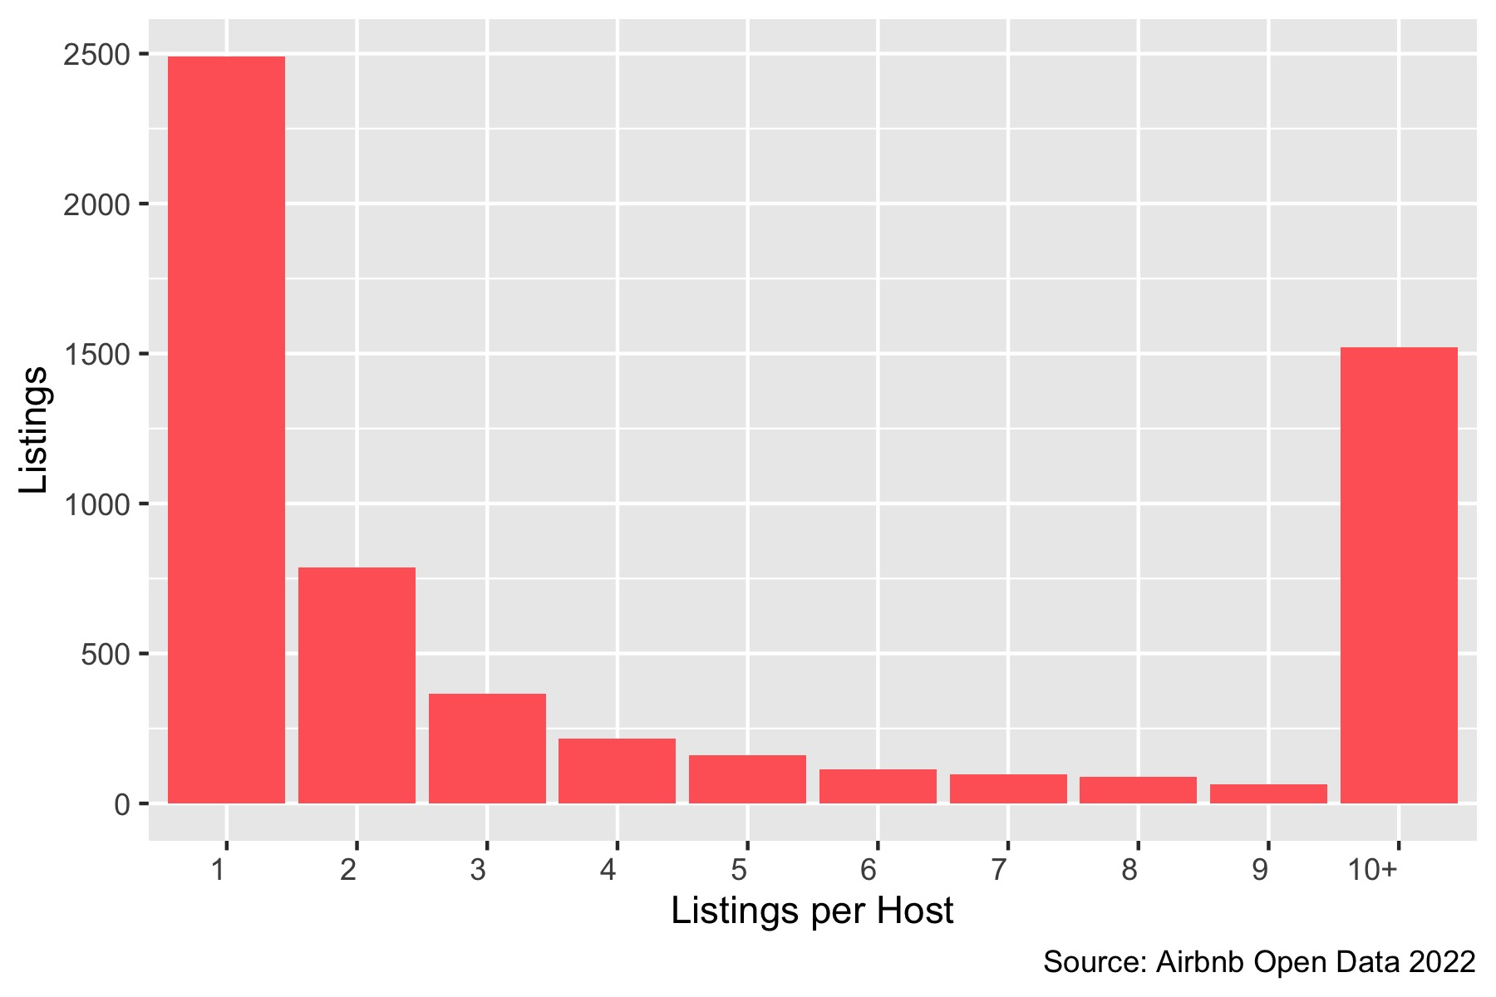
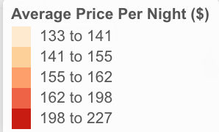
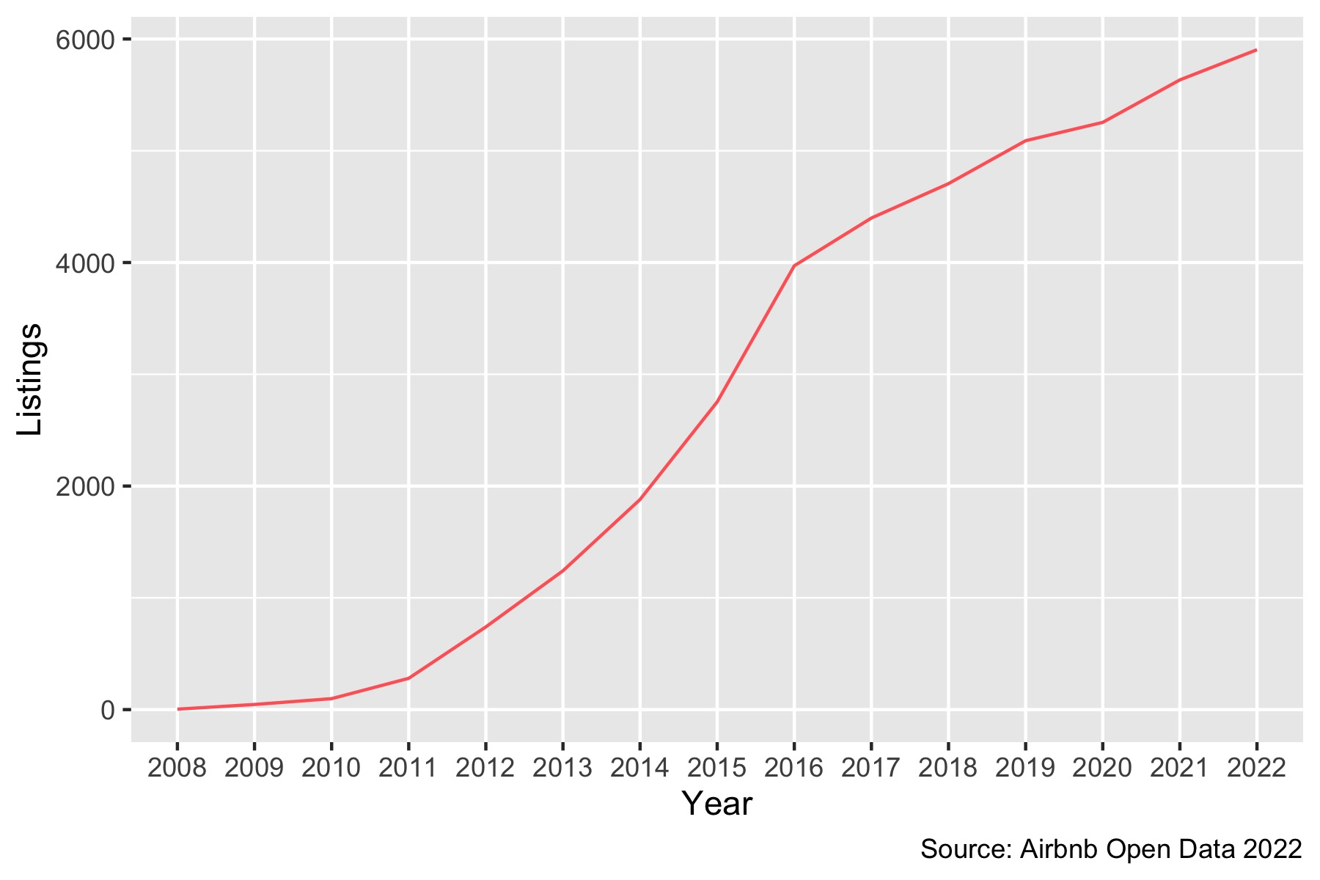
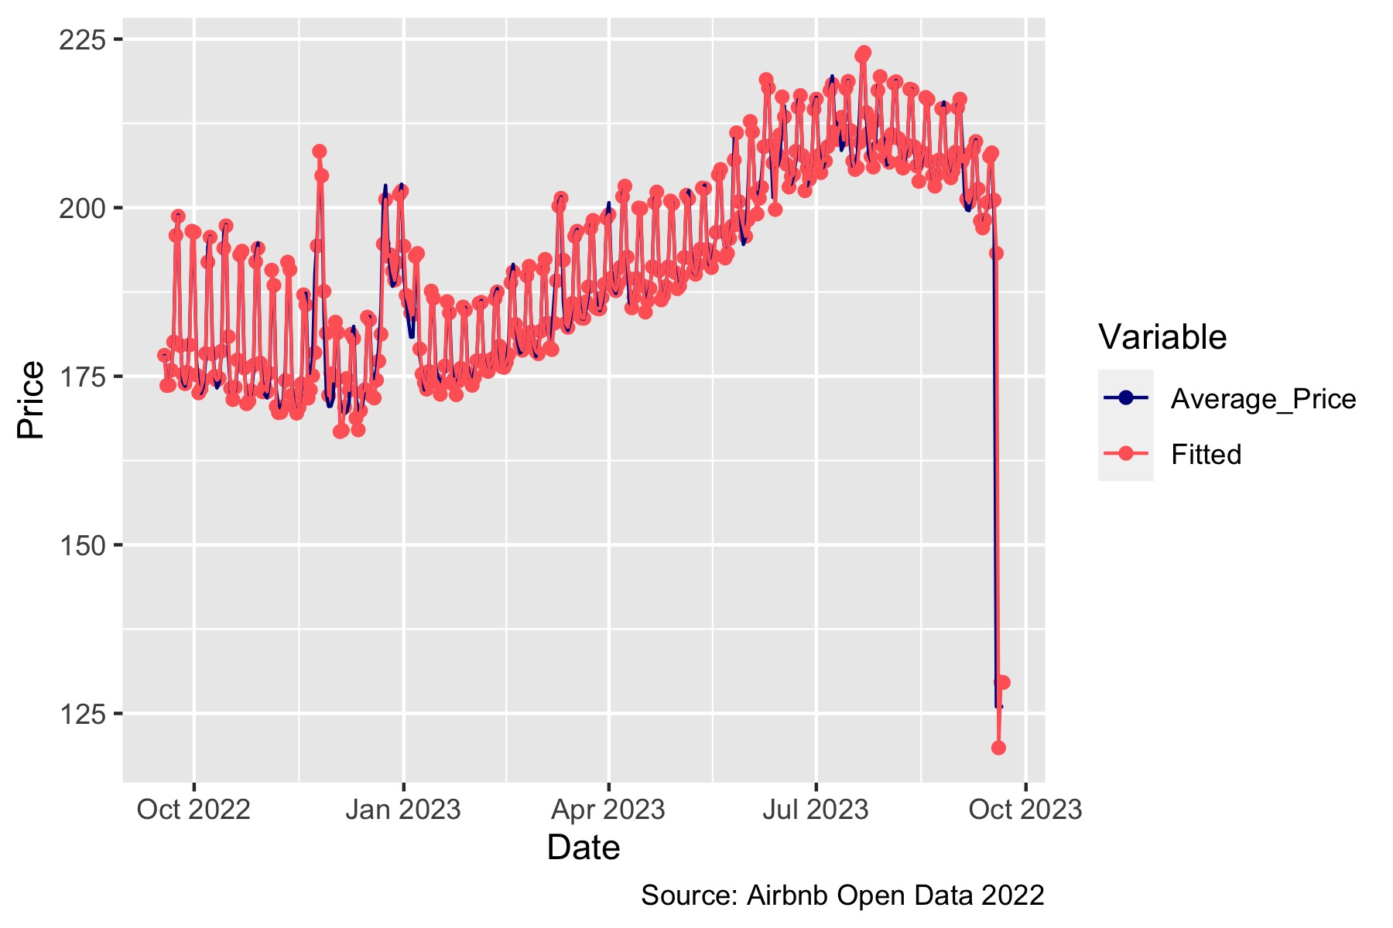
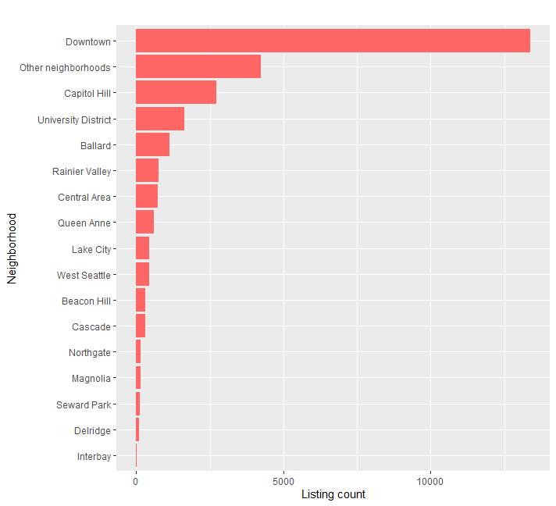
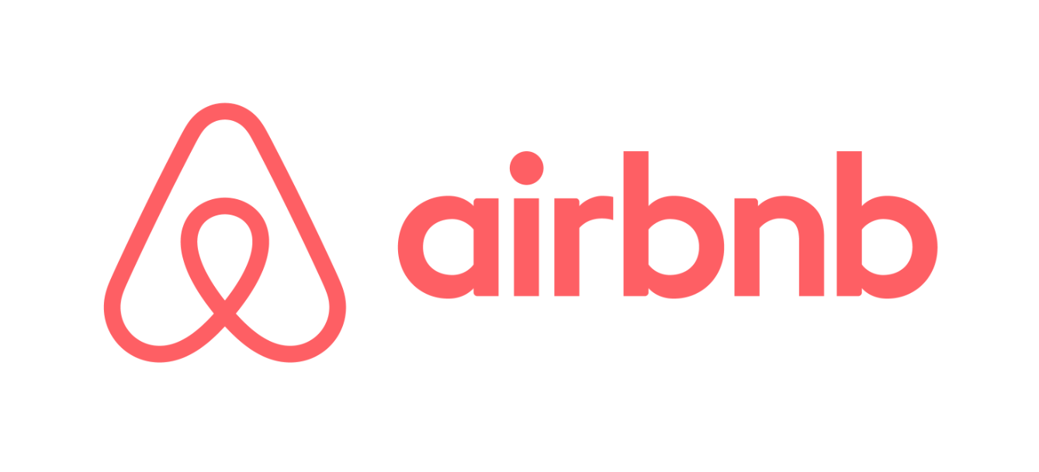
2022 Seattle Airbnb Listings Vien Nguyen, Emily Overend, Connie Pan, Shahid Attar, & Mamoundou Dramera
More Seattle Airbnb Details:
Price of Airbnb listings are higher in the summer
Based on the projected pricing outlook (from September 2022 to September 2023), the listing prices of Seattle Airbnb's are expected to rise in the spring and decline starting in the fall. July is expected to have the highest average price at around $212 per night.
Background:
Seattle is one of the best places to visit in the United States, as it offers a wide range of activities, attractions, and geographical features to explore.
This poster was created to show the growth of Airbnb's over the years, the prices of Airbnb's according to local neighborhoods, and the trend of price over the span of the year.
This schematic is useful to tourists planning their visit, and it is useful to prospective hosts and businesses in making investment decisions.
The range in price per person is higher for Airbnb's that can accommodate a smaller number of people.
Seattle Airbnb hosts with a license or exempt license status charge higher listing prices
Washington State law requires some owners of short-term Airbnb rentals to obtain a business license. It appears that hosts with an exempt license status and hosts with a license charge higher prices than hosts without a license and those with a pending status..
This boxplot shows the average price each person pays by the number of people an accommodation can house (i.e., Accommodation 1 can only accommodate one person.) The range of average price is highest for Airbnb's that accommodate one or two people, and lowest for Airbnb's that accommodate 10 or more people.
Queen Anne neighborhood had the highest average listing price per night
For the year of 2022, the Queen Anne neighborhood had the highest average listing price per night due to the area’s famous tourist attractions. Neighborhoods located closer to downtown also have higher price averages, and neighborhoods located in the center of Seattle have cheaper price averages.
Most Seattle Airbnb hosts offer only one listing
A host on the Airbnb platform can have multiple listings available to rent, ranging from a separate room in their property to multiple apartments or homes. The majority of Seattle hosts offer only one listing on the Airbnb platform.
Seattle Airbnb's continued to grow in recent years, even though growth slowed since 2016
The Airbnb business in Seattle has significantly grown since 2008, and the number of listings has nearly tripled from 2014 to 2022. However, this growth slowed in 2016 due to increased regulation.
Seattle Airbnb price data describes the fitted model data with little error
The observed Seattle Airbnb price data describes the fitted model data proficiently with little error and could potentially be used to make Seattle Airbnb pricing predictions and forecasting.
ARIMA(1,0,1)(0,1,2)
Source: Airbnb Open Data 2022
Most Airbnb's are listed for Seattle's Downtown
The Downtown area has a significantly greater listing count compared to other areas due to the convenience of its proximity to Seattle's popular tourist attractions.
Conclusion:
Airbnb's have grown exponentially in Seattle neighborhoods since 2008, where licensing status becomes significantly important to list in the market.
This growth affects the demands and the prices of Airbnb's from area to area. The location of Airbnb's has a major influence on price, as it provides convenient distances to shops, restaurants, and attractions. This is seen with Airbnb's in the Queen Anne neighborhood, which had the highest average price per night and where popular attractions such as the Space Needle, Museum of Pop Culture, and other attractions are located.
The pricing of Airbnb's is also based on factors such as the licensing status of the host, the number of people an Airbnb can house, and season. Hosts with a license or an exempt licensing status, accommodations for one person, and the summer season have the highest Airbnb prices.
This report will help tourists with planning their visit to Seattle, and it could be a tool for local businesses and service providers when making business decisions.
More Seattle Airbnb details:: https://public.tableau.com/app/profile/shahid.attar/viz/Scattermap_16705265578610/Dashboard1?publish=yes

Slide 2
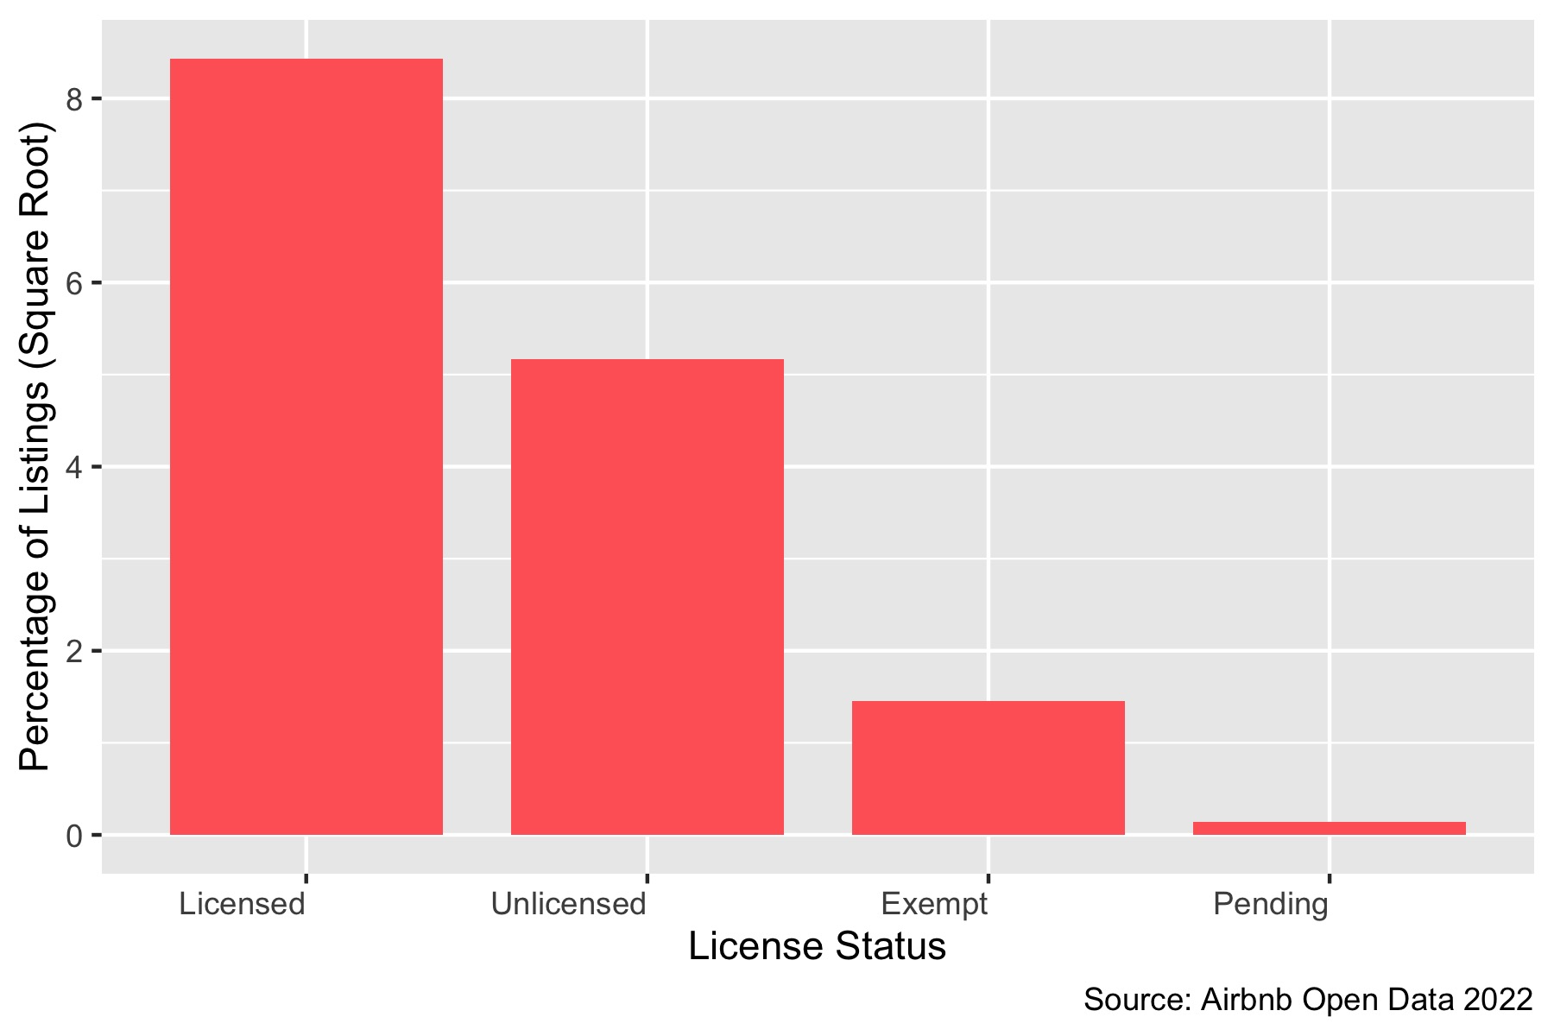
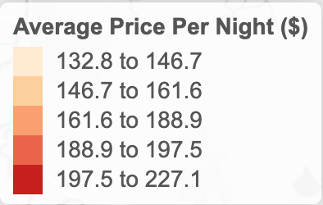
2022 Seattle Airbnb Listings Vien Nguyen, Emily Overend, Connie Pan, Shahid Attar, & Mamoundou Dramera
Price of Airbnb listings are higher in the summer
Based on the projected pricing outlook (from September 2022-2023), the listing prices of Seattle Airbnb are expected to rise in the spring and decline starting in the fall. July is expected to have the highest average price at around $212 per night.
Background:
Seattle is one of the best places to visit in the United States, as it offers a wide range of activities, attractions, and geographical features to explore.
This poster was created to show the growth of airbnbs over the years, the prices of airbnbs according to local neighborhoods, and the trend of price over the span of the year.
This schematic is useful to tourists planning their visit, and it is useful to prospective hosts and businesses in making investment decisions.
License Status of Seattle Airbnb Listings in 2022
Price by Accommodations
Washington State law requires some owners of short-term Airbnb rentals to obtain a business license. As of 2022, the majority of Seattle Airbnb listings owned by individuals have acquired a license; however, approximately 26% of the listings are operated without a license.
This boxplot shows the average price by accommodation. The more accommodations the higher the average price. Also, the price range increases with the accommodations.
2022 Seattle Average Price per Night by Neighborhood
For the year of 2022, the Queen Anne neighborhood had the highest average listing price per night due to the area’s famous tourist attractions. Neighborhoods located closer to downtown also have higher price averages, and neighborhoods located in the center of Seattle have cheaper price averages.
Listing Per Host in 2022
A host on the Airbnb platform can have multiple listings available to rent, ranging from a separate room in their property to multiple apartments or homes. The majority of the Seattle hosts offer only one listing on the Airbnb platform.
Seattle Airbnb Listings Growth 2008-2022
The Airbnb business in Seattle has significantly grown since 2008. The number of listings has nearly tripled from 2014 to 2022.
Conclusion:
Airbnb has grown exponentially in Seattle neighborhoods since 2008 where the licensed status becomes significantly huge in order to list in the market.
This growth affects the demands and also increases the price of hosts from area to area, and therefore, location becomes the major component selection because it provides many tourist attractions and security.
The pricing of Airbnbs is based on many factors such as the type of hosts, the area, and reviews. In addition, the demands are higher in summer compared to any other season due to the chance to see and do many outdoor events and sightseeing in good weather.
In summary, many factors show that Airbnb is constantly growing in demands and prices.
This report will help people to understand what causes the high listing and how to be better prepared for their needs.
Planning and Modeling Ideas:
Price/growth prediction for October-December 2022 and comparing it to 2021.
Growth density change maps over time.
Publishing interactive average price map as a website and creating QR code for poster.
Source: Airbnb Open Data 2022

Slide 3
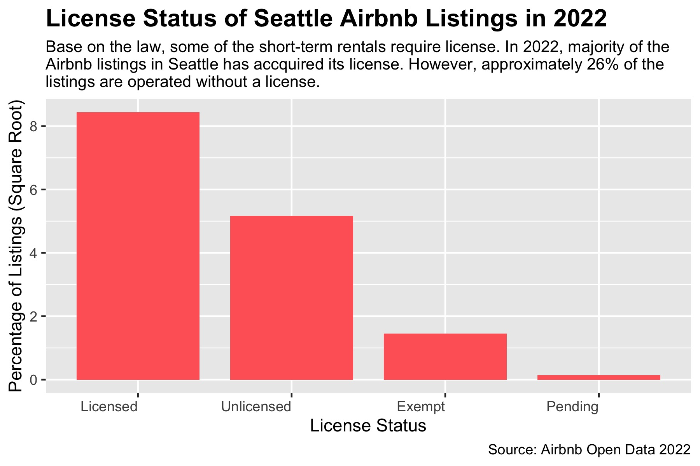
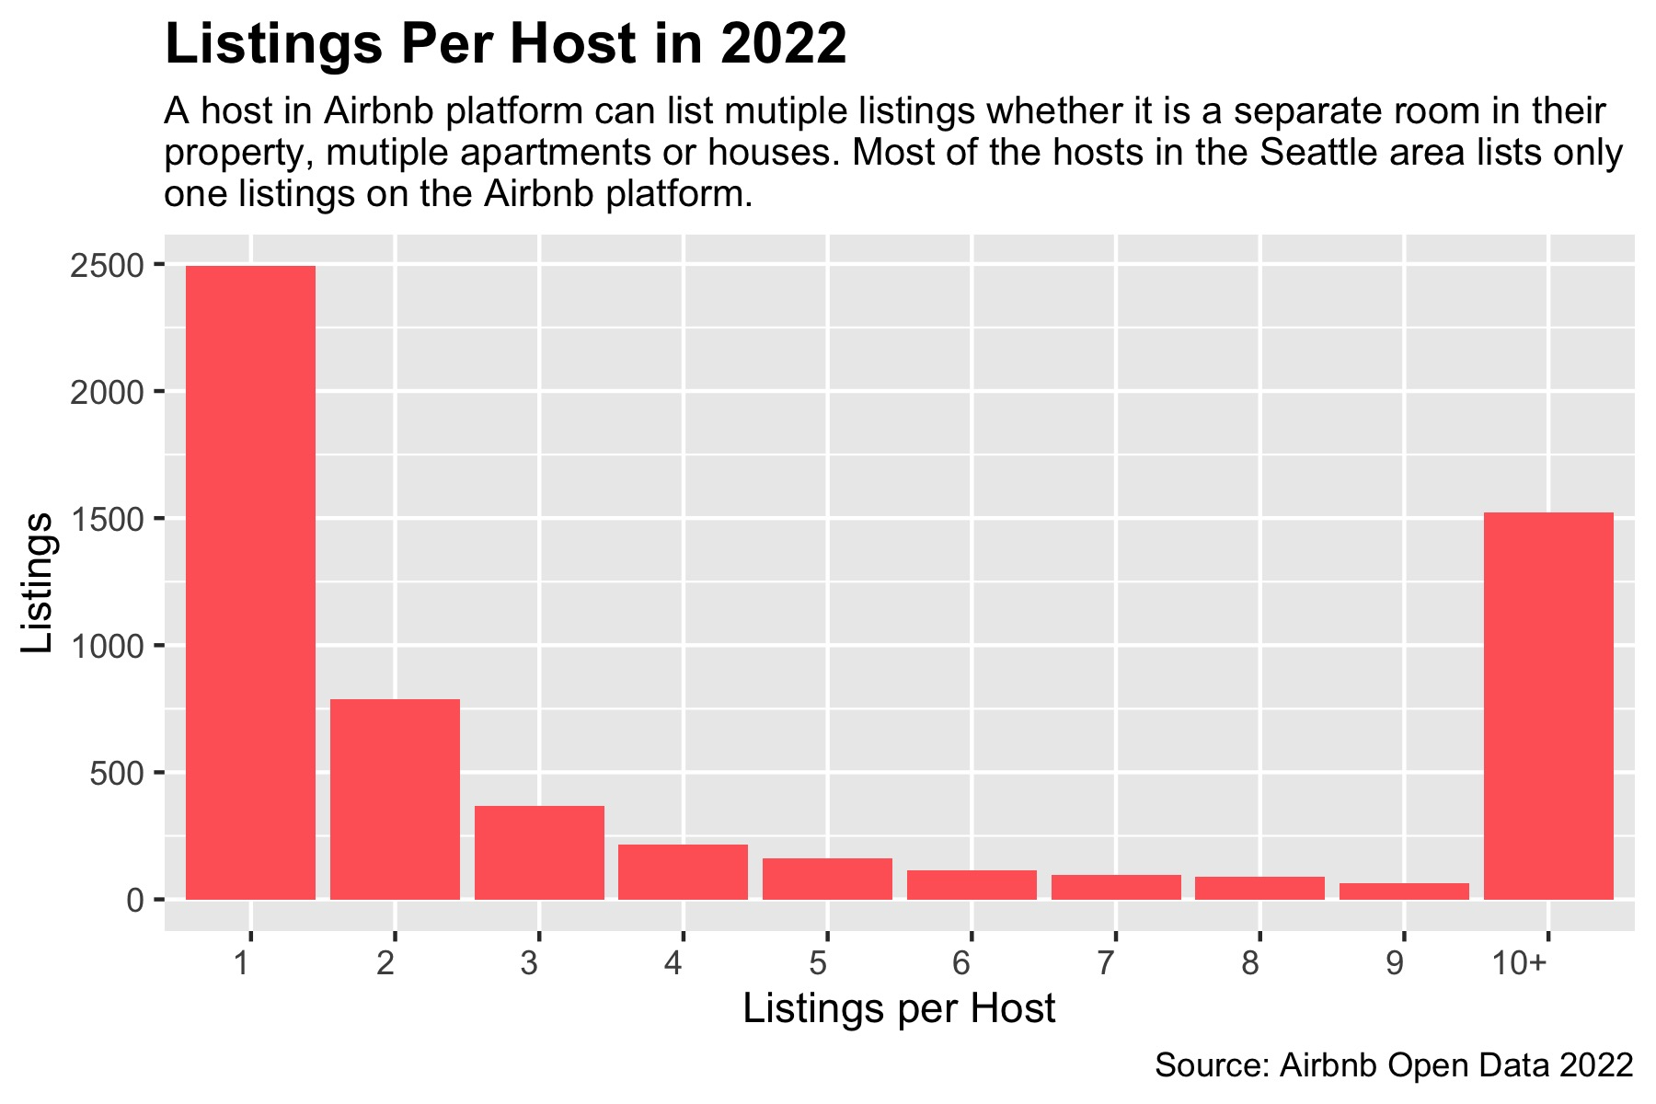
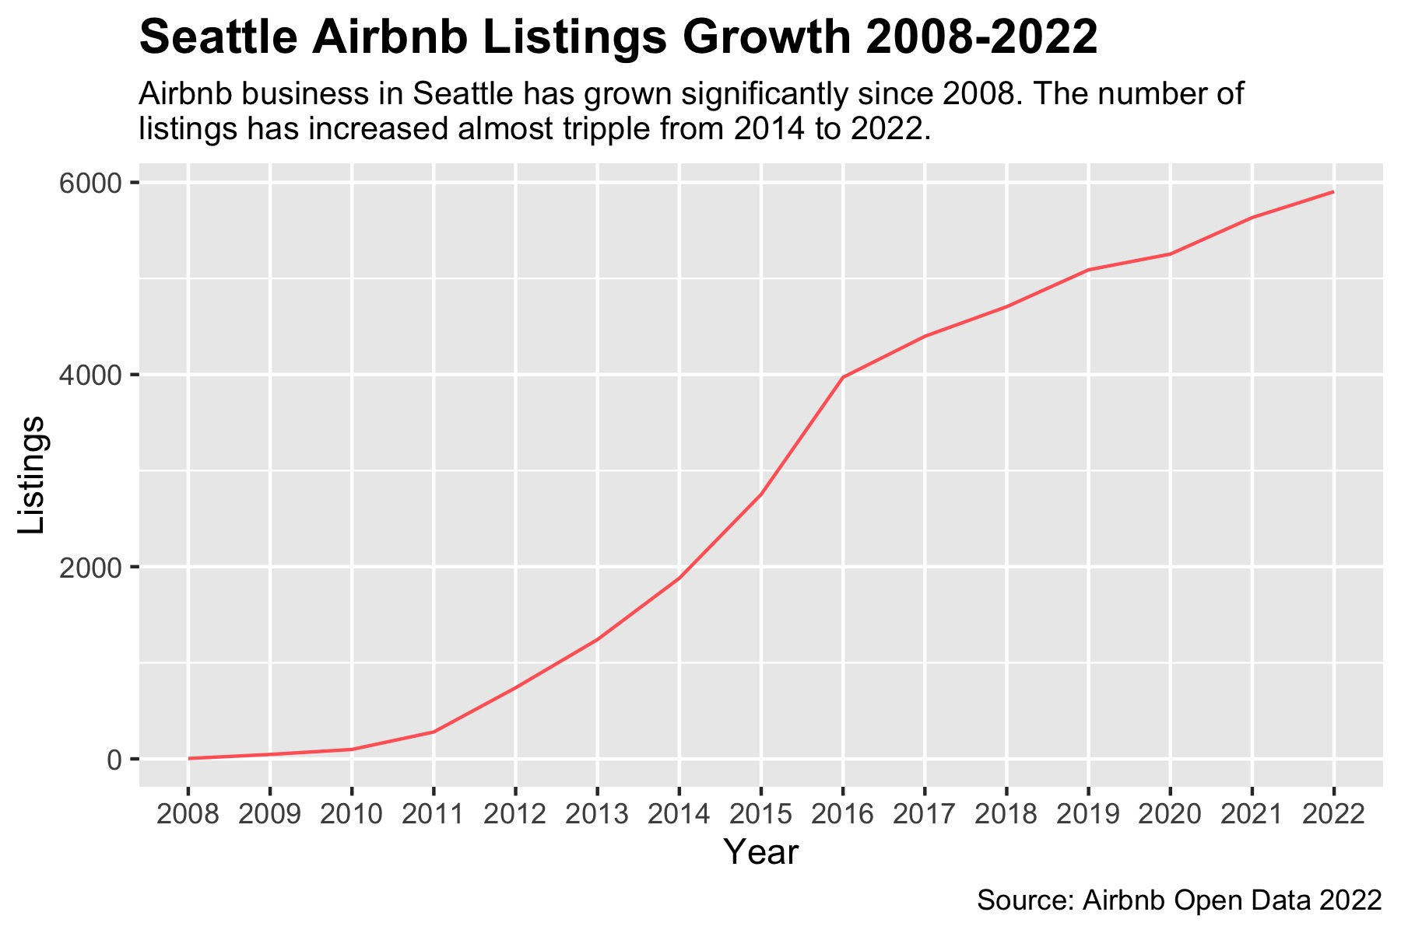
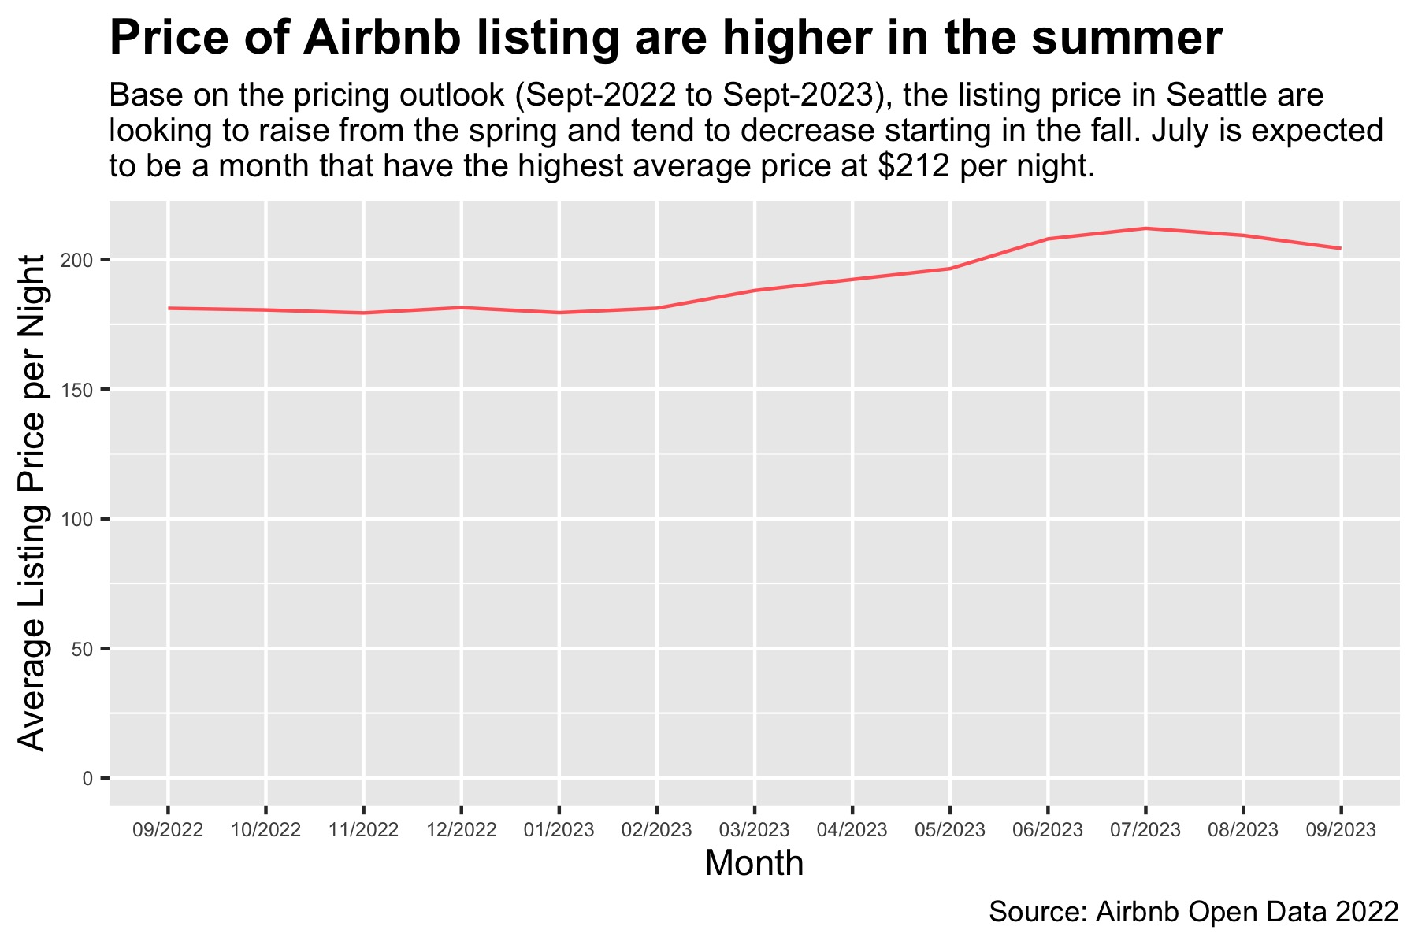
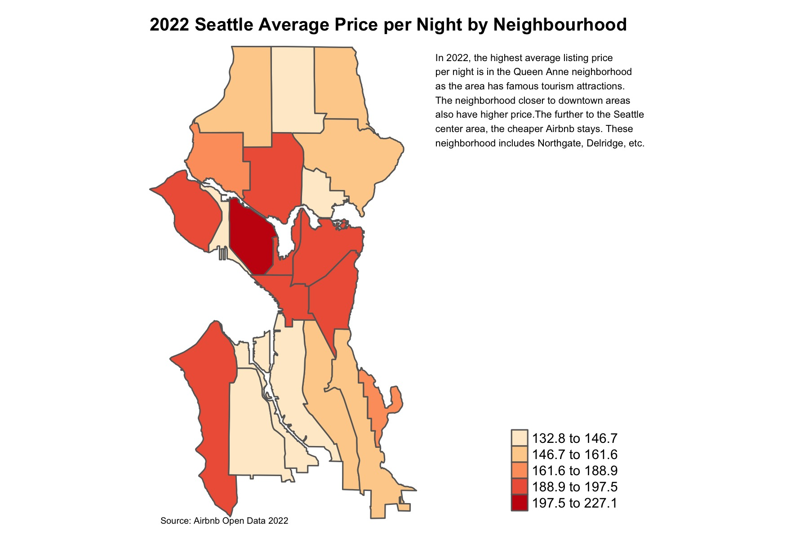
Raw Graphs

Slide 4
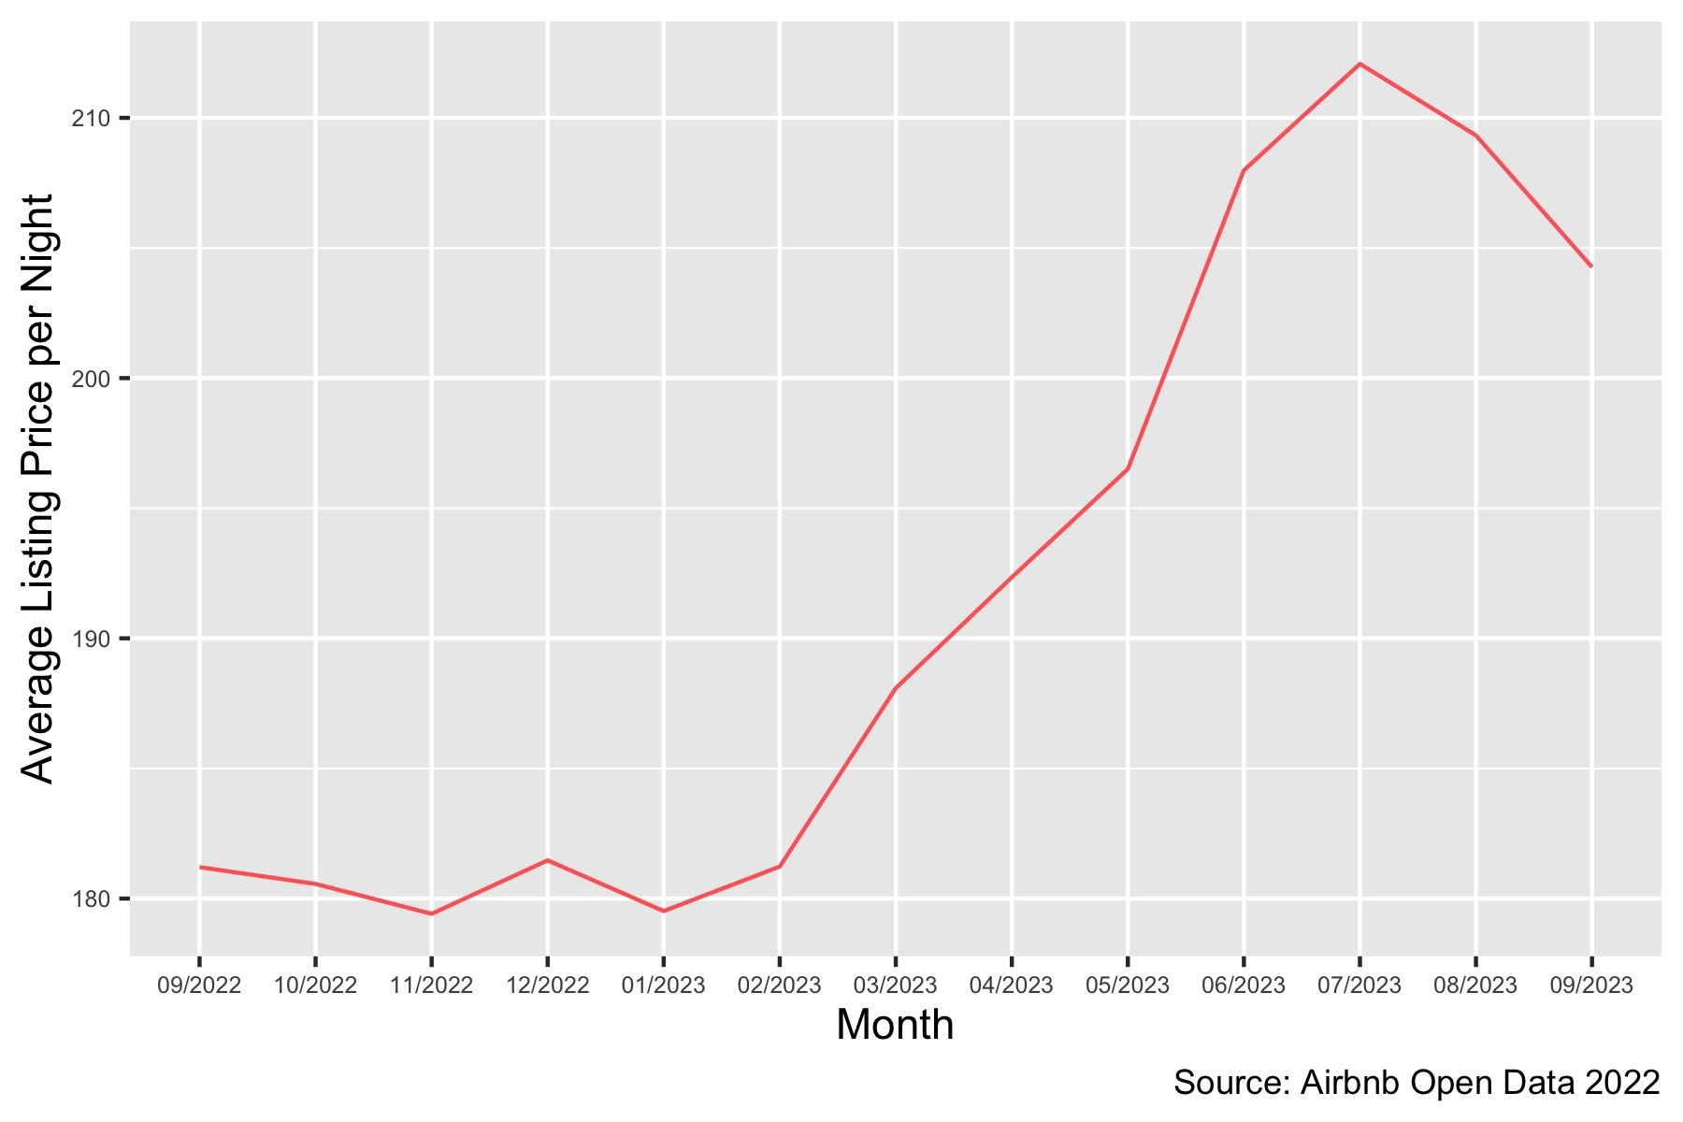
2022 Seattle Airbnb Listings
License Status of Seattle Airbnb Listings in 2022
Washington State law requires some owners of short-term Airbnb rentals to obtain a business license. As of 2022, the majority of Seattle Airbnb listings owned by individuals have acquired a license; however, approximately 26% of the listings are operated without a license.
Price of Airbnb listings are higher in the summer
Based on the projected pricing outlook (from September 2022-2023), the listing prices of Seattle Airbnb are expected to rise in the spring and decline starting in the fall. July is expected to have the highest average price at around $212 per night.
2022 Seattle Average Price per Night by Neighborhood
For the year of 2022, the Queen Anne neighborhood had the highest average listing price per night due to the area’s famous tourist attractions. Neighborhoods located closer to downtown also have higher price averages, and neighborhoods located in the center of Seattle have cheaper price averages.
Seattle Airbnb Listings Growth 2008-2022
Listing Per Host in 2022
The Airbnb business in Seattle has significantly grown since 2008. The number of listings has nearly tripled from 2014 to 2022.
A host on the Airbnb platform can have multiple listings available to rent, ranging from a separate room in their property to multiple apartments or homes. The majority of the Seattle hosts offer only one listing on the Airbnb platform.
Source: Airbnb Open Data 2022

Slide 5
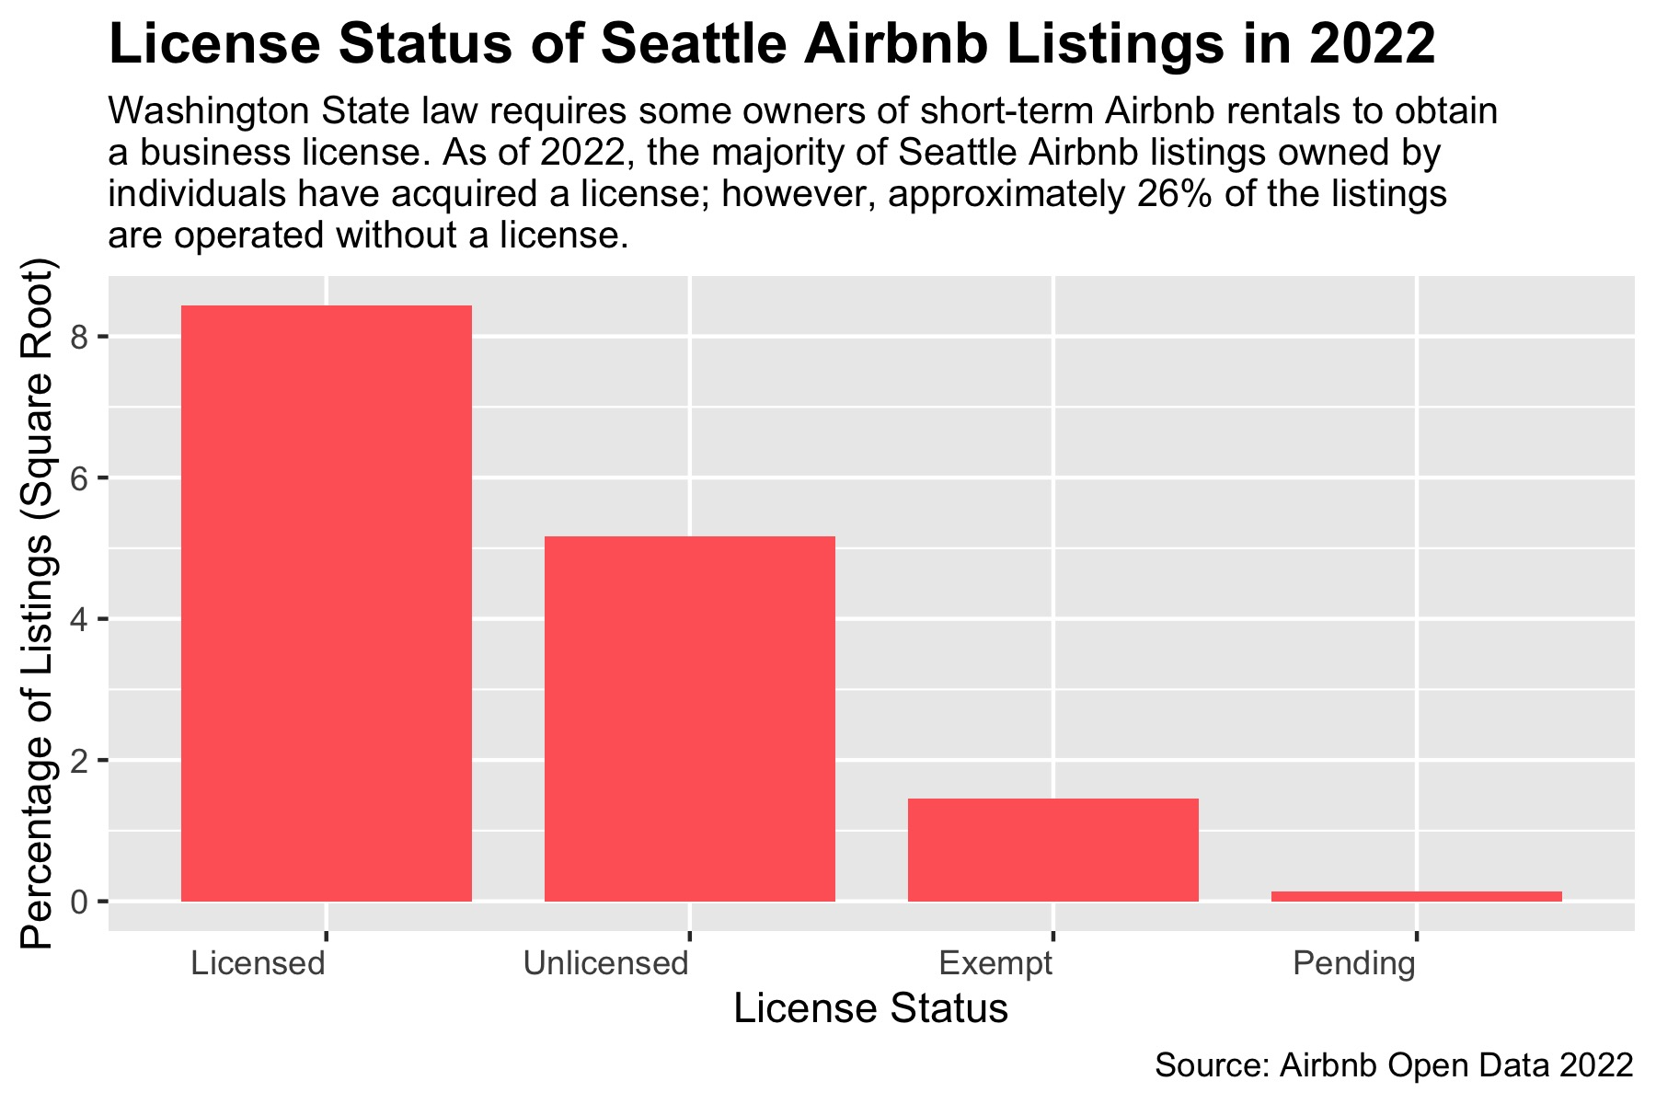
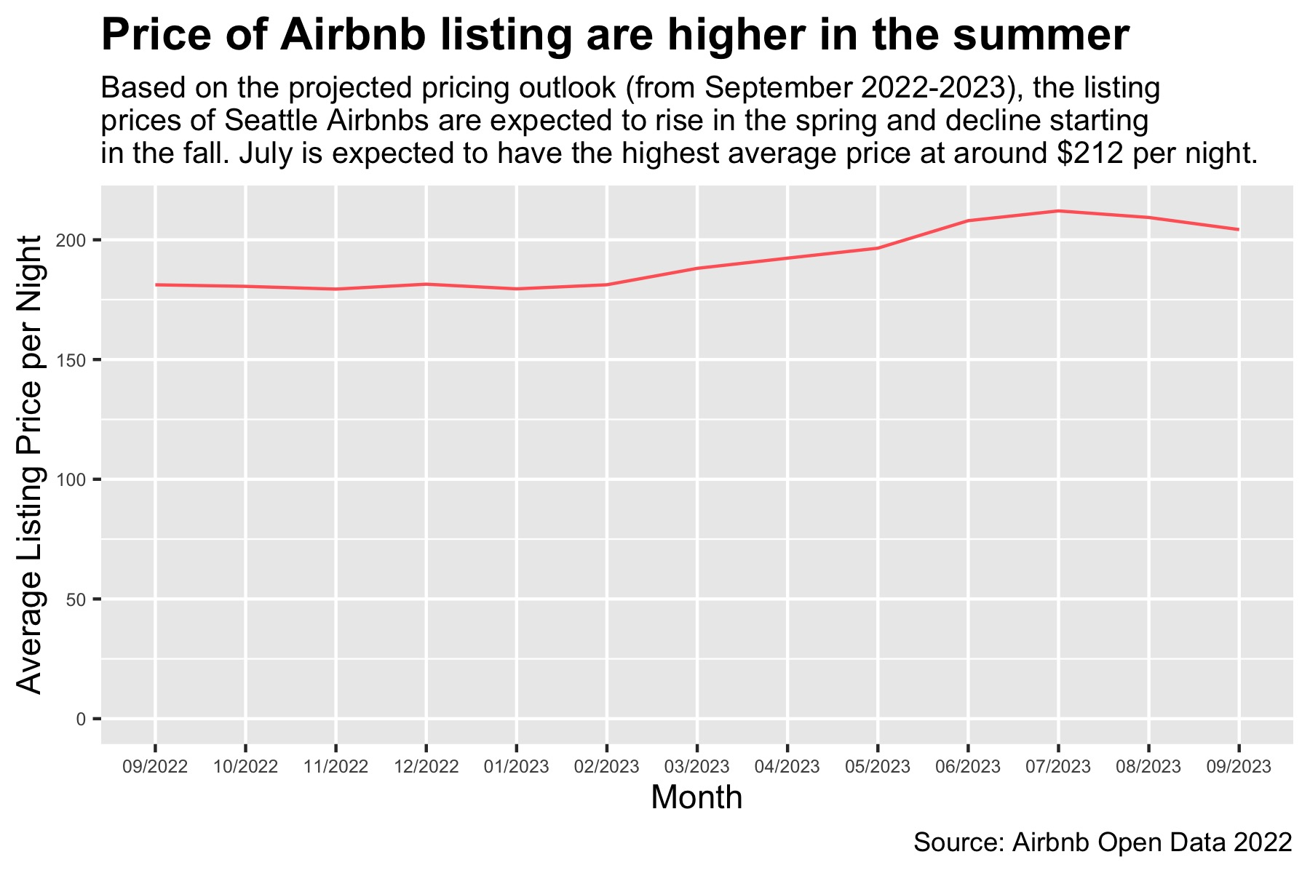
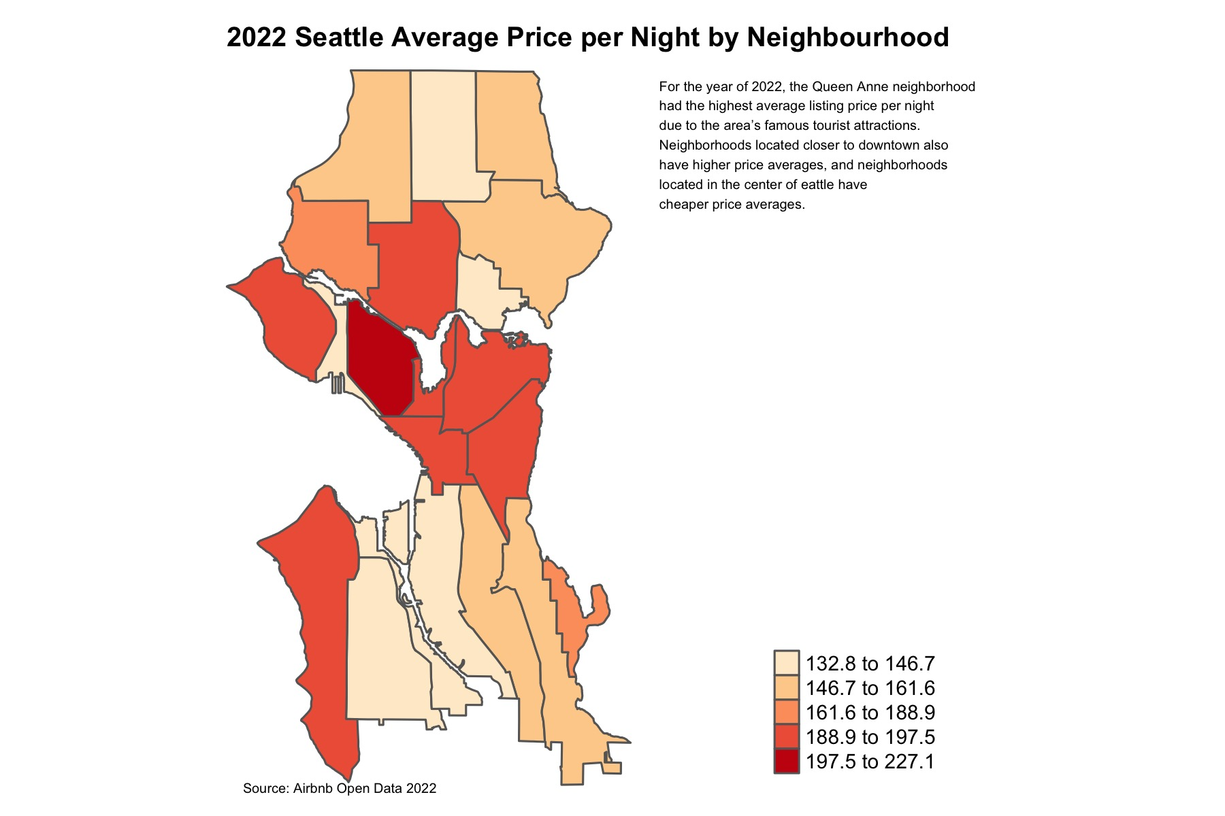
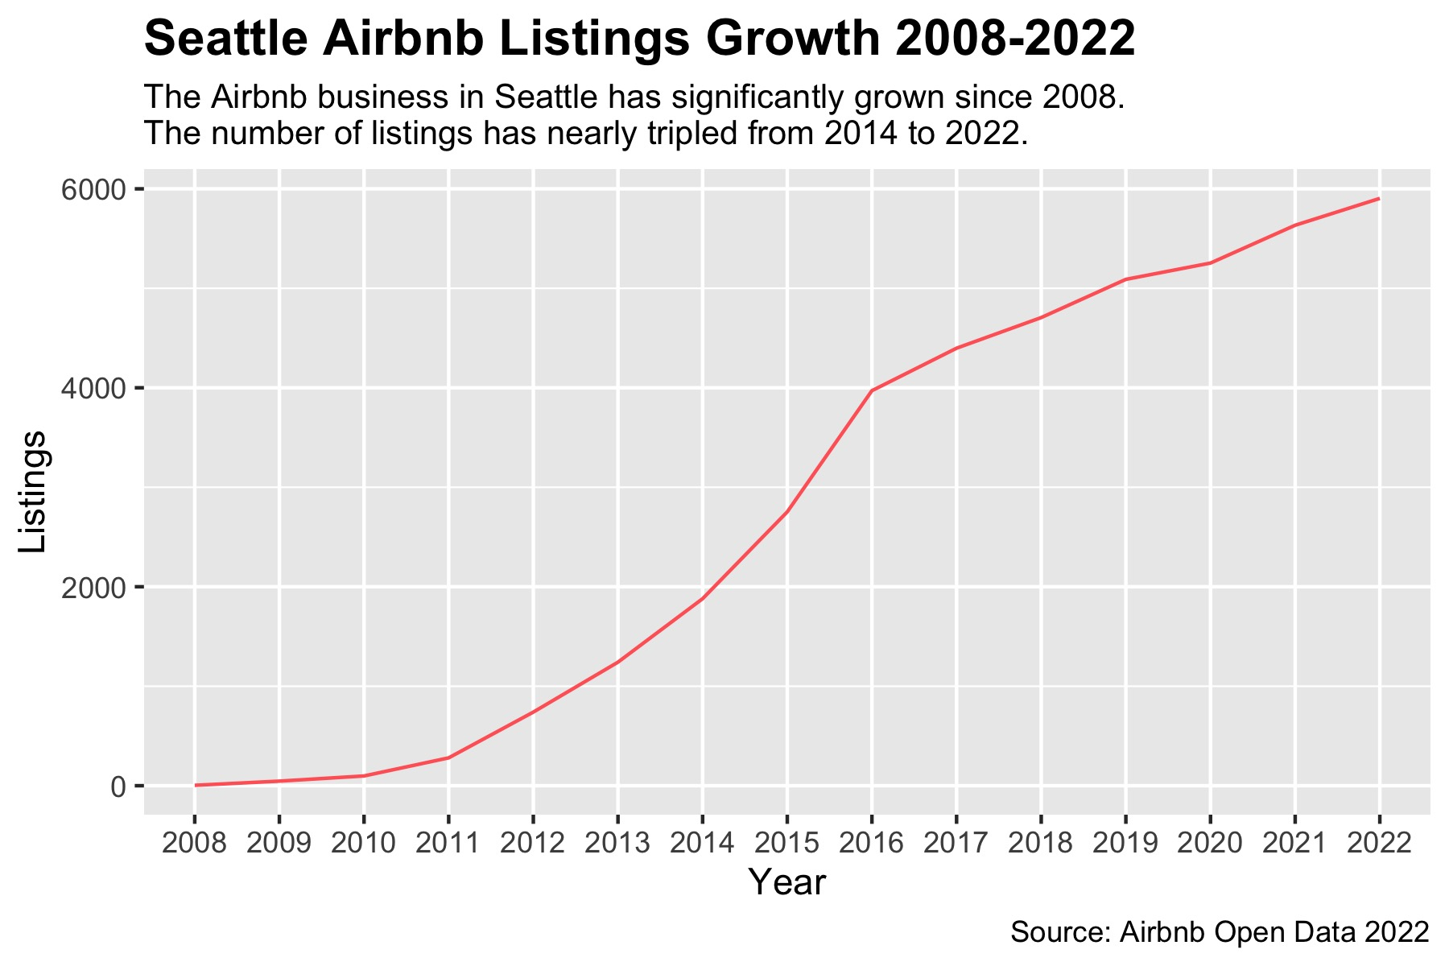
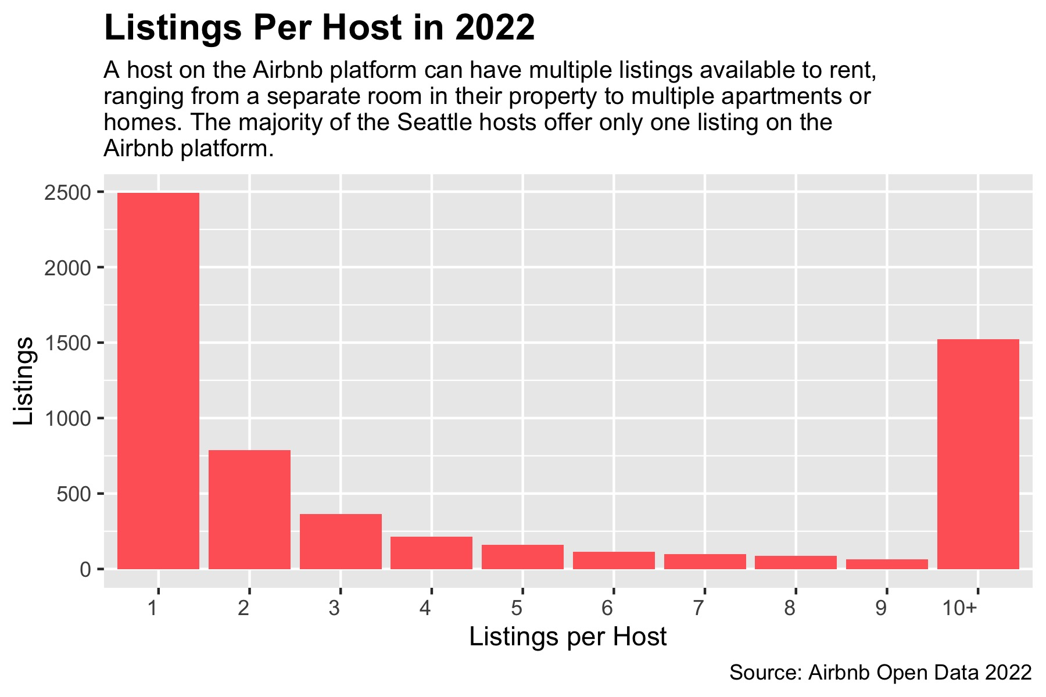
2022 Seattle Airbnb Listings

